Slide 1





ATLIQ GRANDS
HOSPITALITY
DOMAIN
BY ACHAL YADAV

Slide 2


CONTENT
01
02
03
04
AtliQ Grands
Values
Problem Statement
Project Timeline
05
06
07
Project Initiation
Review and Editing
Presentation and sharing

Slide 3


ATLIQ GRANDS
AtliQ Grands is a famous chain of five-star hotels in India, known for its luxury and excellent service. For 20 years, they have offered a blend of modern comfort and traditional charm. Their hotels provide a top-notch experience for travelers, making AtliQ Grands a popular choice for those seeking a high-quality stay.

Slide 4






VALUES
Luxury & Comfort
Exceptional Service
Cultural Charm
Prime Locations
AtliQ Grands offers elegant and luxurious accommodations designed to provide the utmost comfort for guests
The staff at AtliQ Grands are dedicated to providing top-notch, personalized service to ensure a memorable stay.
Each hotel combines modern amenities with traditional Indian charm, offering a unique and enriching experience.
AtliQ Grands hotels are situated in prime locations across India, making them convenient and attractive for travelers.

Slide 5



PROBLEM STATEMENT
01
Despite its strong reputation, the company is currently facing significant challenges. Increased competition from other luxury and business hotels, coupled with ineffective decision-making within its management team, has led to a decline in market share and revenue.
02
To address these pressing issues, AtliQ Grands' managing director has decided to integrate "Business and Data Intelligence" into their operations. The primary goal is to leverage data-driven insights to make informed decisions and devise effective strategies to regain market share and boost revenue

Slide 6




PROJECT TIMELINE
Presentation and Sharing
Review and Editing
Project Initiation

Slide 7




PROJECT INITIATION
February
April
Data Collection
Dim_date
Dim_hotels
Dim_rooms
Fact_aggre_bookings
Fact_bookings
The dim_date table includes dates for May, June, and July, formatted as "monthname year" and paired with unique week numbers. It also classifies each date as either a Weekend or Weekday.
The fact_aggregated_bookings table includes hotel IDs, customer check-in dates, room types (e.g., RT1, RT2), counts of successful bookings, and room capacities for each type on specific dates.
The dim_hotels table provides details on each hotel, including a unique ID, name, classification (Luxury or Business), and location city.
The fact_bookings table records details of each booking, including unique IDs, booking and check-in/check-out dates, room types, number of guests, booking platform, customer ratings, status, and revenue information.
The dim_rooms table includes room types (e.g., RT1, RT2) and their corresponding classes (Standard, Elite, Premium, Presidential).

Slide 8
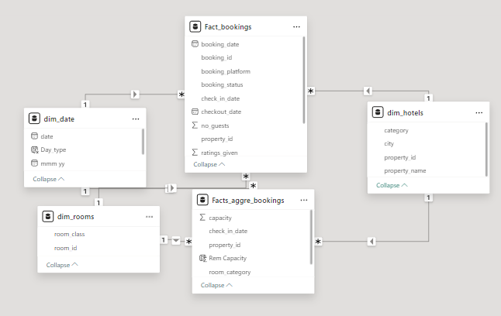

PROJECT INITIATION
February
April
Building relationship
Star Schema
The star schema was used to structure the data for efficient analysis. It includes central fact tables (fact_bookings and fact_aggregated_bookings) that record booking details and aggregated metrics. Dimension tables (dim_date, dim_hotels, and dim_rooms) provide contextual information such as dates, hotel properties, and room types. This schema simplifies data relationships, improves query performance, and supports flexible data analysis.

Slide 9
PROJECT INITIATION
February
April
Some Common Termologies related to domain
ADR
DBRN
(Average Daily rate)
It is the ratio of revenue to the total rooms booked/sold.
It is the measure of the average paid for rooms sold in a given time period
(Daily Booked Room Nights)
This metrics tells on average how many rooms are booked for a day considering a time period
Realisation %
DSRN
It is nothing but the succesful "checked out" percentage over all bookings happened.
(Daily Sellable Room Nights)
This metrics tells on average how many rooms are ready to sell for a day considering a time period
RevPAR
DURN
(Revenue Per Available Room)
RevPAR represents the revenue generated per available room, whether or not they are occupied. RevPAR helps hotels measure their revenue generating performance to accurately price rooms.
(Daily Utilized Room Nights)
This metric tells on average how many rooms are succesfully utilized by customers for a day considering a time period

Slide 10


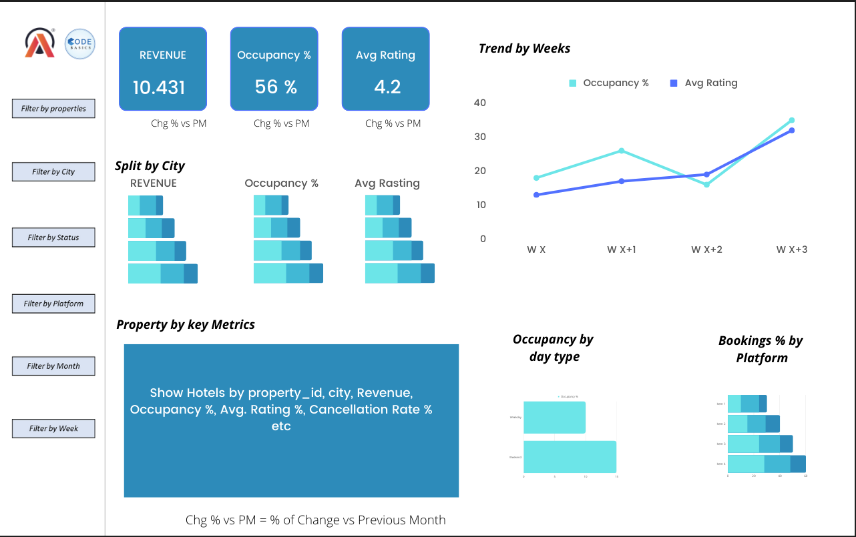
REVIEW AND EDITING
During this phase, we will focus on reviewing and refining the dashboard mockups, conducting stakeholder meetings, and making necessary adjustments based on feedback.

Slide 11

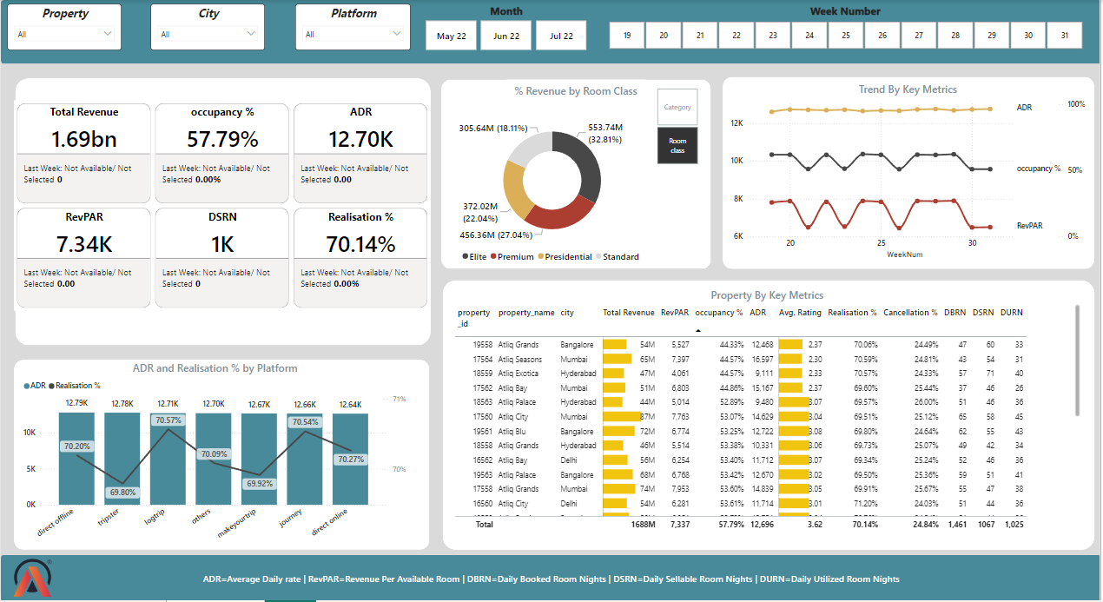

PRESENTATION AND SHARING
This final phase includes the presentation of the finalized dashboards, insights, and recommendations to stakeholders.
To View Live DashBoard

Slide 12




ABOUT ME
Achal Yadav
Find Insights from Messy Data
+91-7987847684
www.linkedin.com/in/achalyadav007

Slide 13



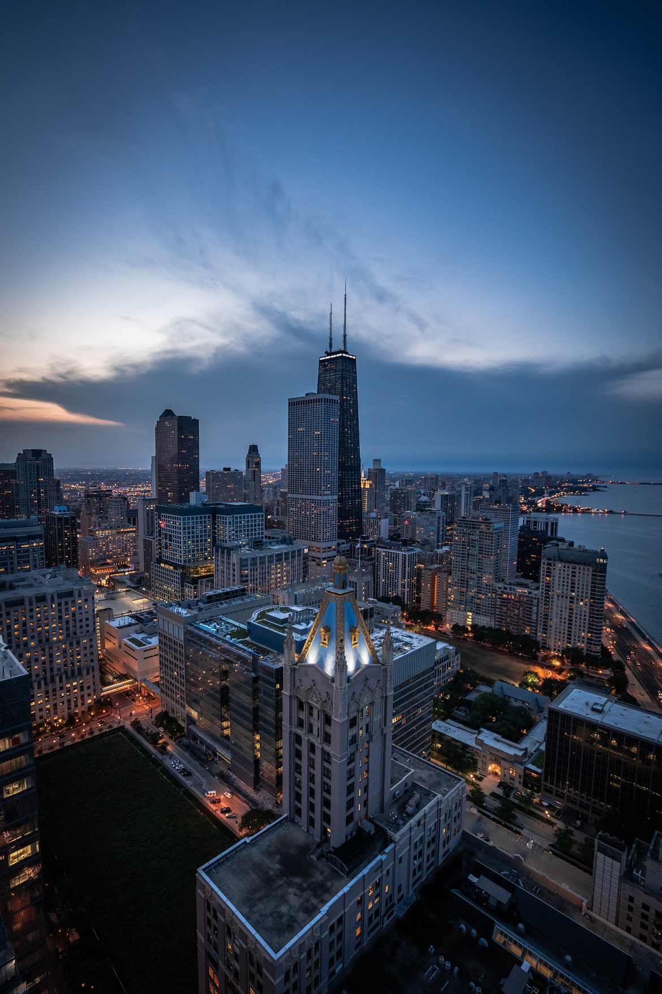


ATLIQ GRANDS
THANK'S FOR WATCHING

